Slide 1
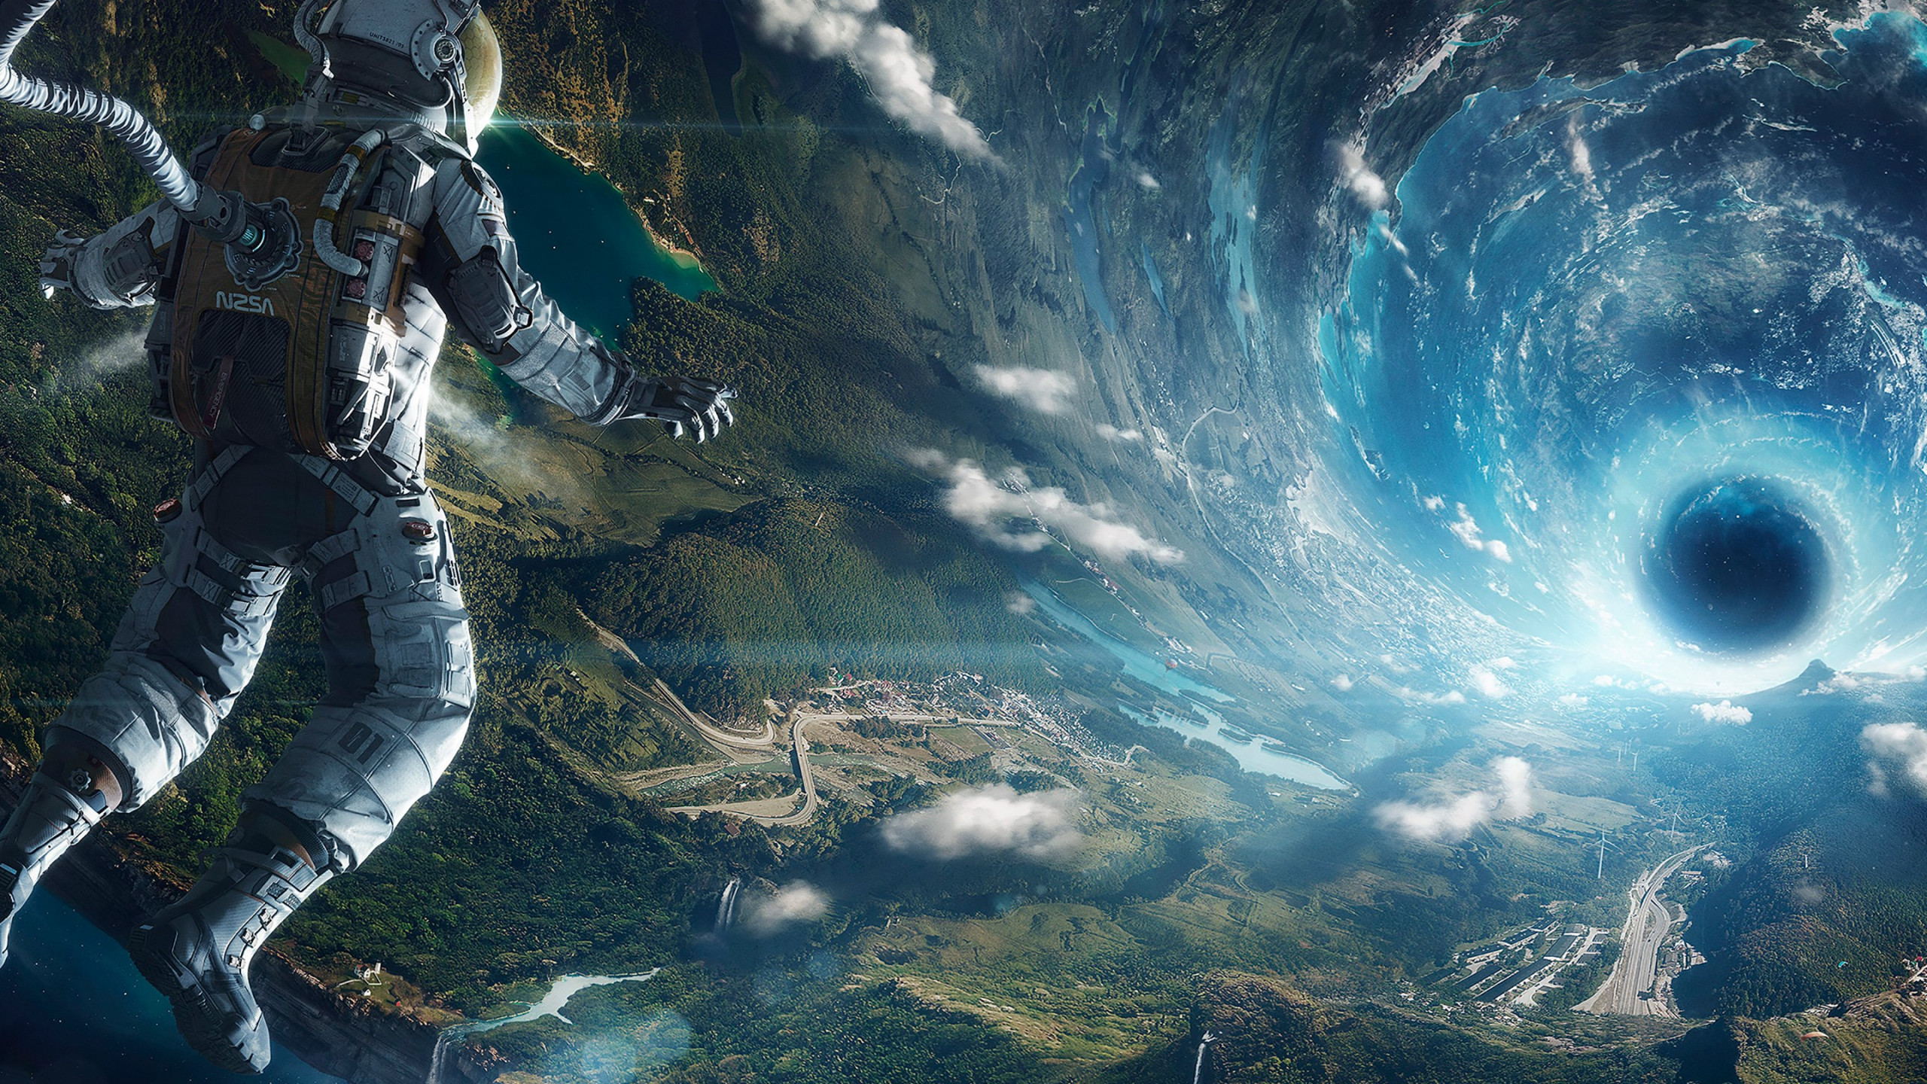
Navigating
the Cosmos
Notes:
Hello Instructors! Our topic of the presentation is Navigating the cosmos.

Slide 2

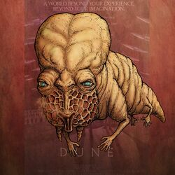
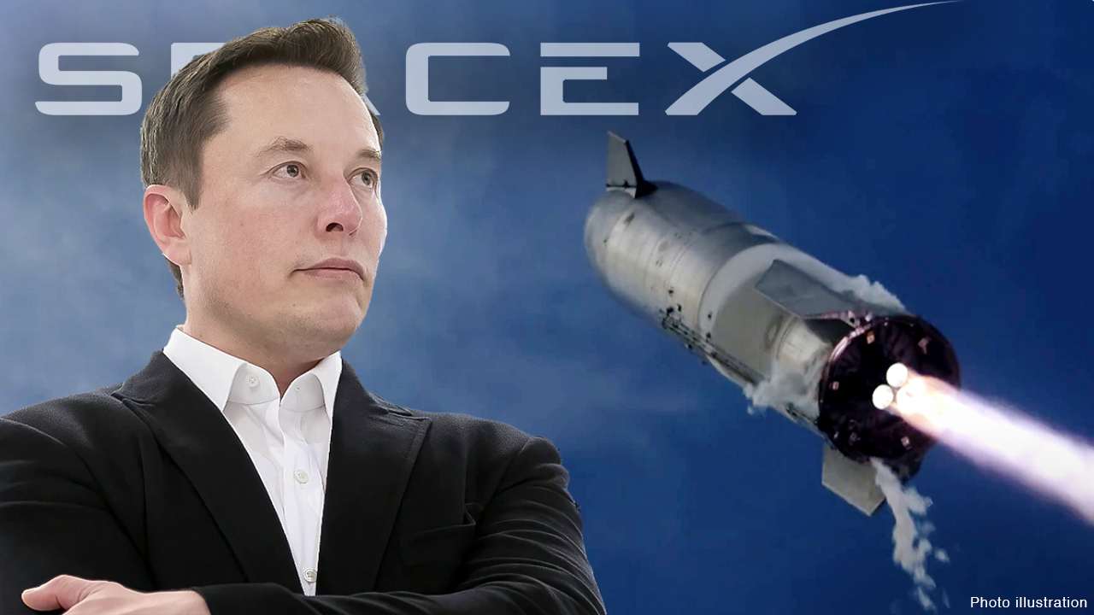
Introduction
Space Travel~~~
Notes:
Our inspiration comes from several famous scientific movies Like dune series, it has space navigator and Spaceship from Star wars series. And we also get inspiration from Elon Musk and his SpaceX company. Space Travel is excited and we want to make some contributions to it.

Slide 3
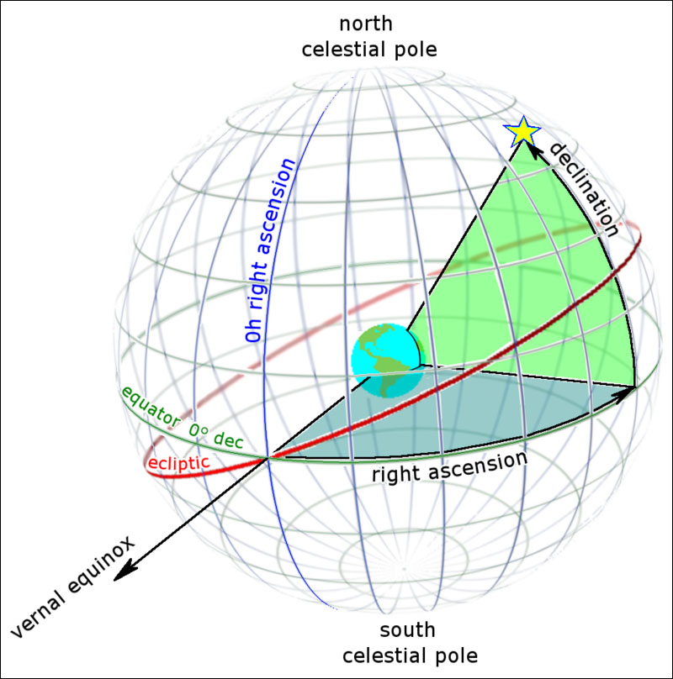
Pin a star in the sky
Three numbers to pin a point:
Right Ascension
Declination
Distance
And we will convert it into cartesian coordinate system.
We choose Earth to be our origin.
Notes:
Our universe is super super enormous, there are billions of stars in the galaxy. So the first thing we need to do is to pin the position of star in the sky. There are many celestial coordinate system, and we chose the earth to be the origin of the system. Because it is the most easy way to represent

Slide 4
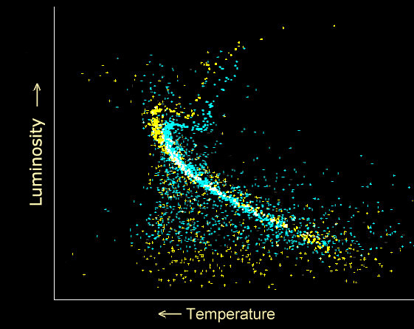
Star Luminosity and Color
Luminosity is calculated based on:
1. Magnitude in G-band
2. Parallax (related to distance)
Color is calculated based on the Temperature, using the formula:
Blue photometer - Red photometer
Notes:
The G-band is a specific passband of light that is used in photometric systems to measure the brightness of stars. And its luminosity will also infected by the parallax. Star color will be calculated using the Blue photometer and Red photometer. They measures the brightness of stars in the blue or red parts of the electromagnetic spectrum.

Slide 5
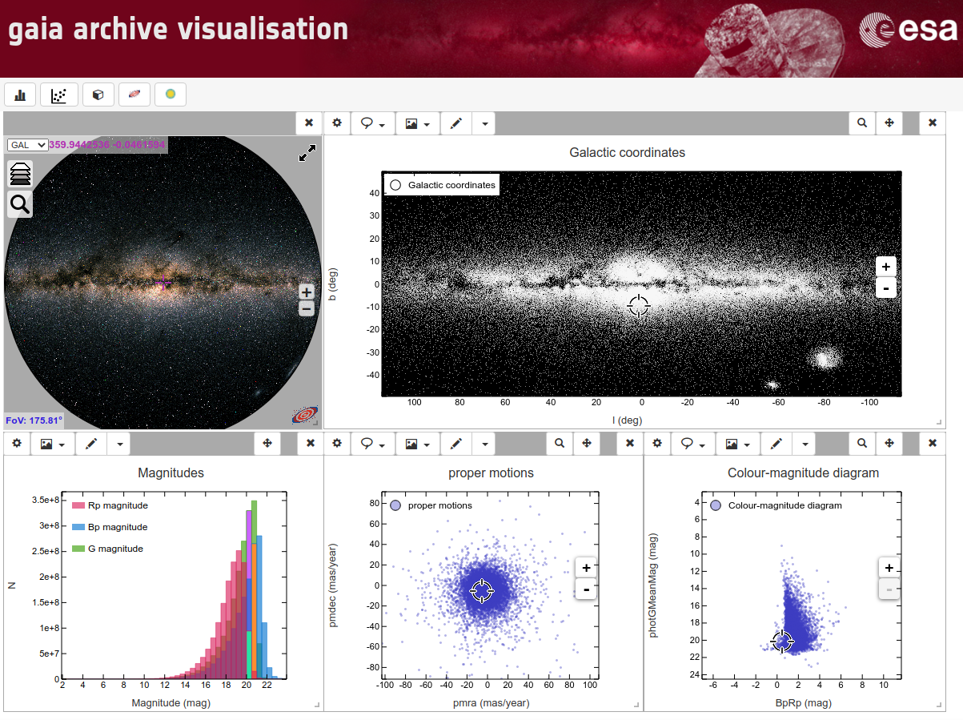

Gaia database and Astropy
Notes:
Gaia is a mission by the European Space Agency aimed at creating a precise 3D map of over a billion stars in our galaxy. Astropy is a Python library used by astronomers for handling data, performing calculations, and analyzing celestial objects.

Slide 6
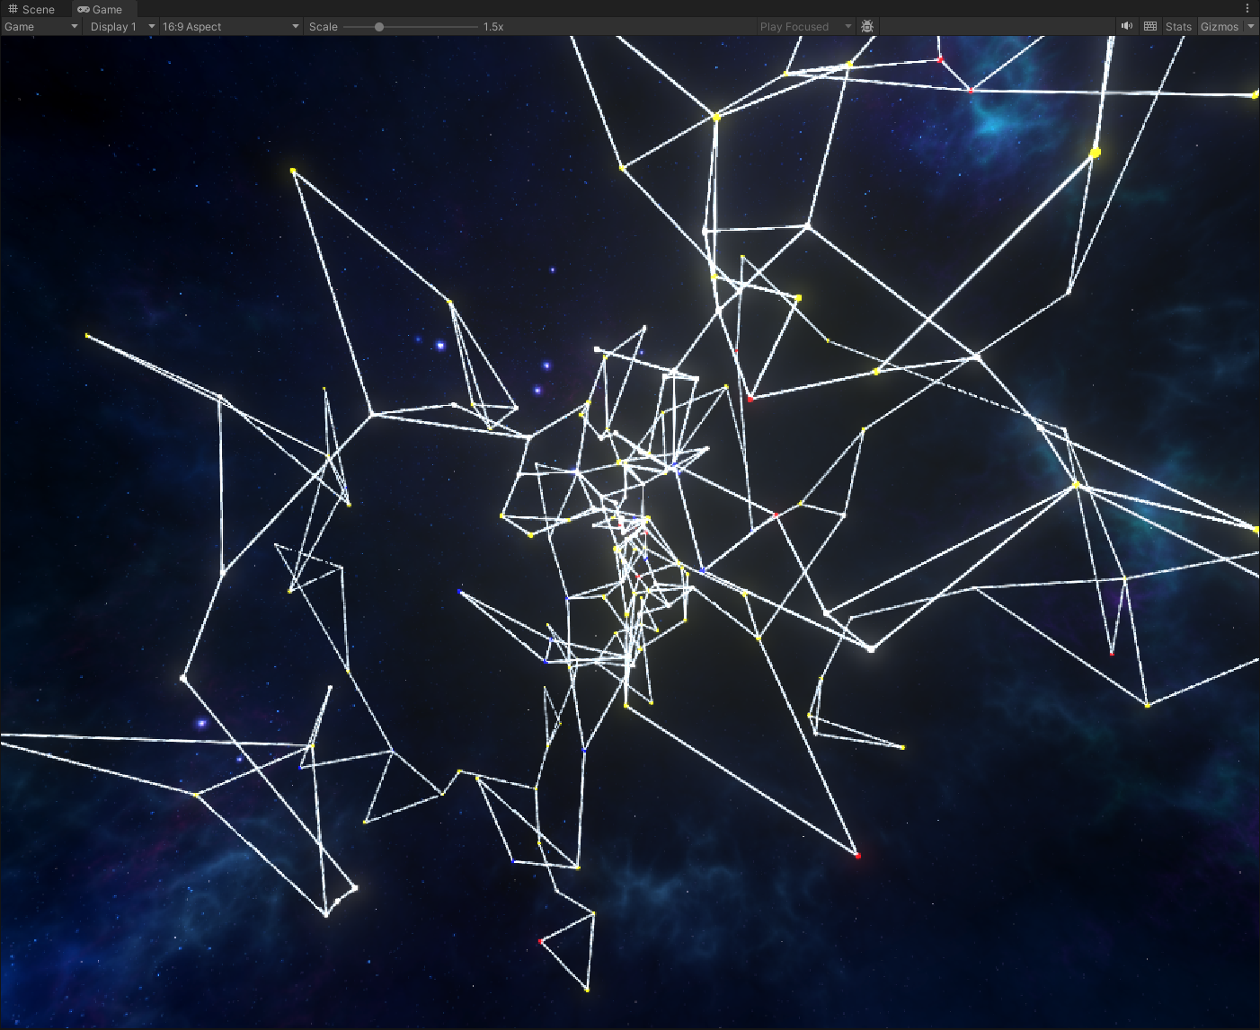
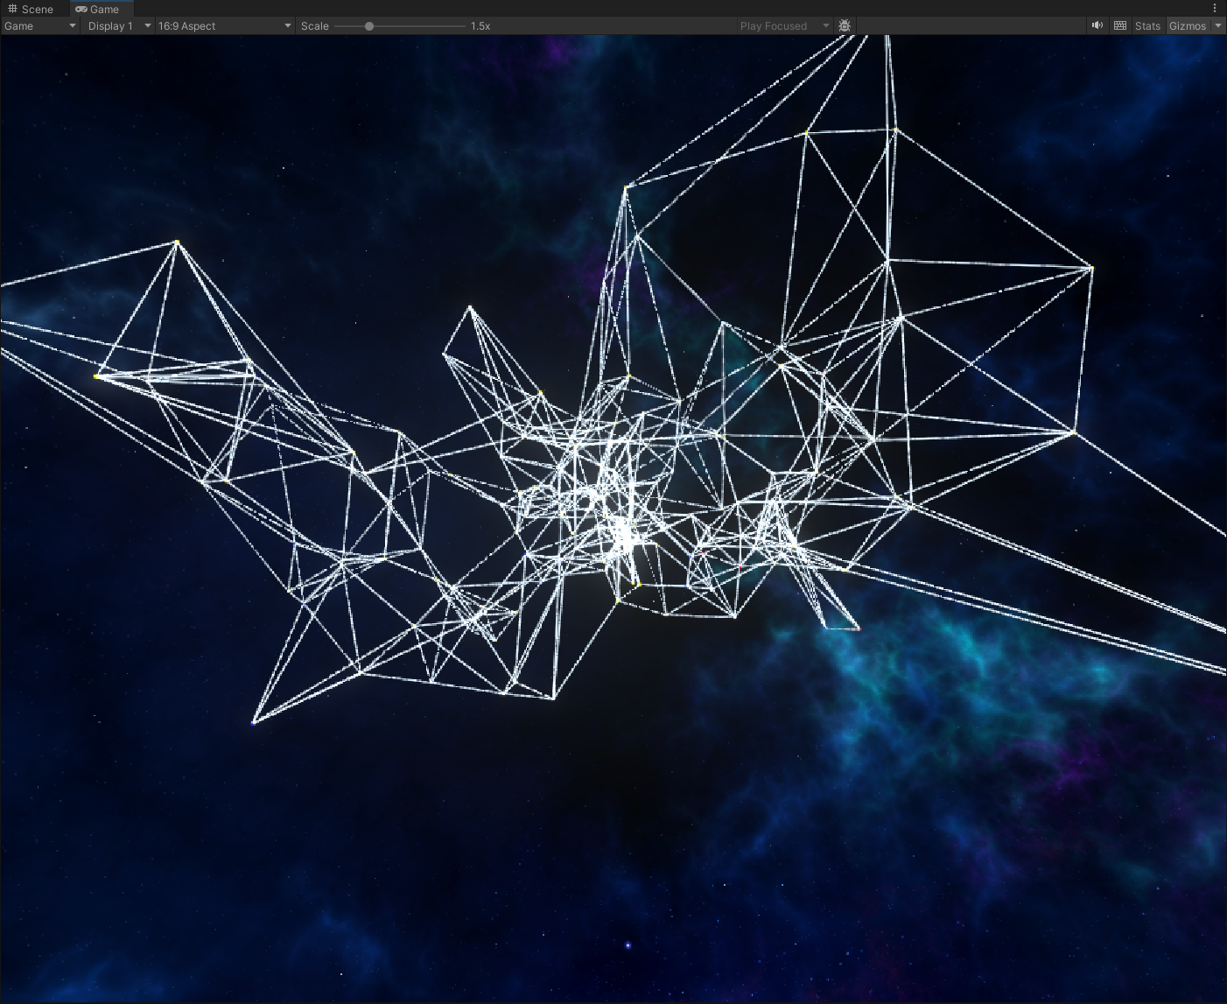
Star Graph Builder
Algorithm (KNN algorithm):
Node Identification: Each data point is treated as a node in the graph.
Distance Calculation: Calculate the distance between each node and every other node in the dataset.
Neighbor Selection: For each node, identify the closest K neighbors.
Edge Creation: Create edges between each node and its K neighbors.
😋
Modification:
Path connectivity: Once the graph found that this node is connected to the whole graph, it will not try to connect this one.
Data storage: Store edges, vertices, and neighbor list to make the calculation of other algorithms more convenient.
Visualization of the graph! Using the Unity Engine Material System to do the work.
🫨
Notes:
Path connectivity: This will make the graph more readable and will make sure every node is connected.

Slide 7
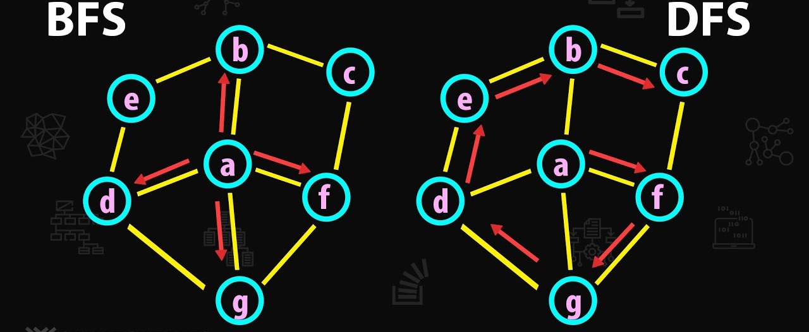
Star Graph Navigation
DFS is a graph traversal method that explores as far as possible along each branch before backtracking. It uses a stack (either explicitly or via recursion) to keep track of the next vertex to visit.
BFS explores all neighbors at the current depth before moving on to nodes at the next depth level. It uses a queue to manage the set of next vertices to explore.

Slide 8
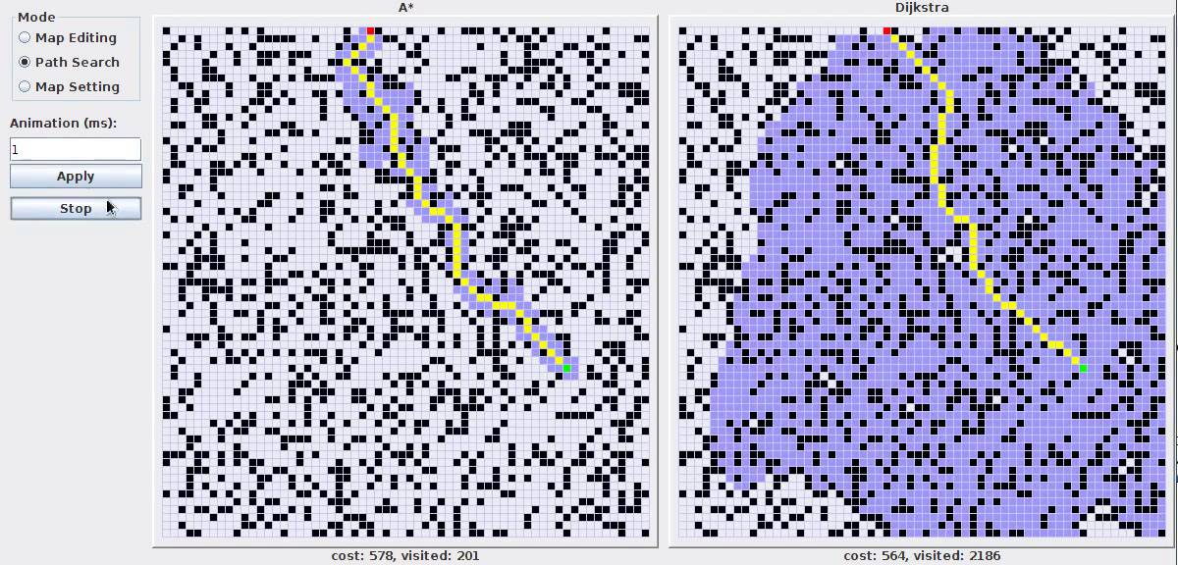
Star Graph Navigation
A* combines the best features of Dijkstra’s algorithm and a heuristic-based search to efficiently find the shortest path to a goal by estimating the costs from the current node to the end using a heuristic.
Dijkstra’s algorithm methodically calculates the shortest path from a starting node to all other nodes in a graph using a priority queue to explore the least costly paths first.

Slide 9
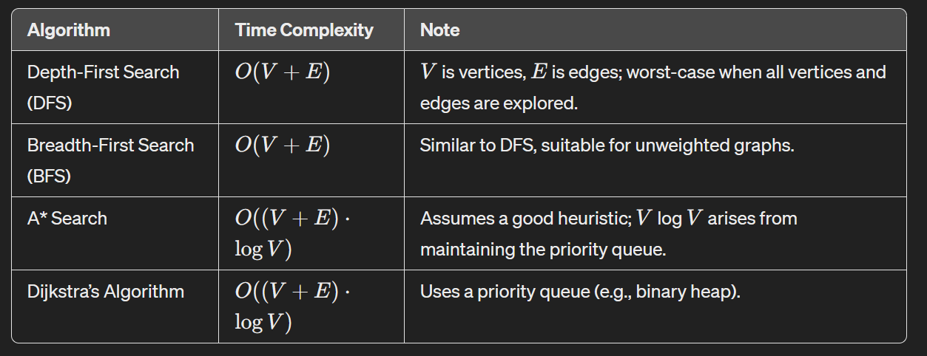
Star Graph Navigation
These are the algorithms we have implemented:
Depth-First Search
Breadth-First Search
A* Search
Dijkstra’s Algorithm
Modification:
Unified Graph Struture
Reconstruct Path
Visualization and Debugging
Notes:
However, A* can be significantly faster in practice due to its use of heuristics, which effectively prune large parts of the search space by estimating the cost to reach the goal from each node.

Slide 10
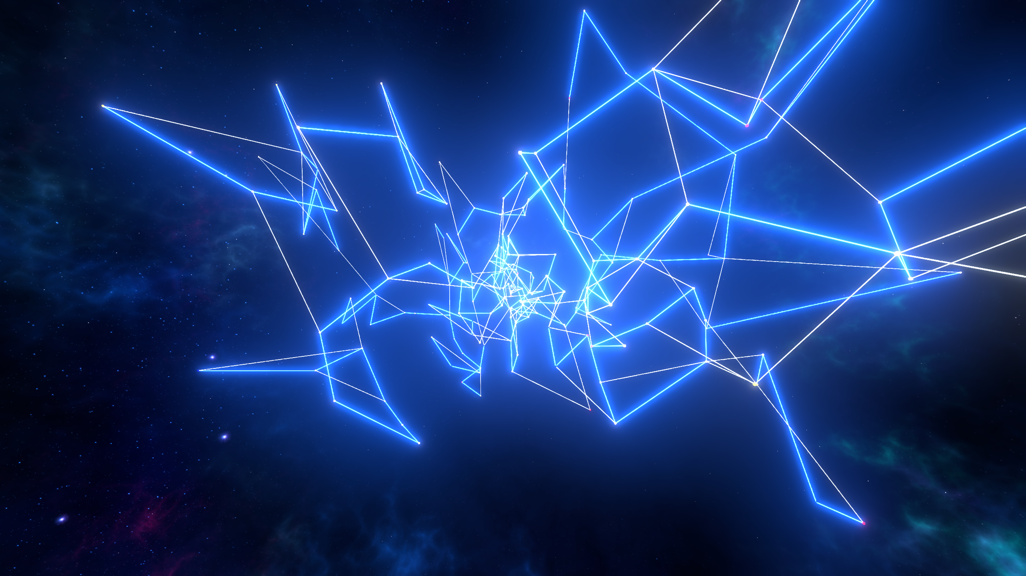
Star Traversal
Finding the shortest path traversal all stars is an NP-Hard problem.
So we use greedy algorithm to find an almost best solution. This is the algorithm we made our selves. Here are the steps:
Initialization:
A random vertex is selected as the starting point.
This vertex is marked as visited, and it's added to the traversal path.
Finding the Nearest Unvisited Neighbor:
From the current vertex, the algorithm looks for the closest unvisited neighbor.
This neighbor is then marked as visited, added to the path, and becomes the new current vertex.
Continuation and Handling Dead-ends:
This process of moving to the nearest unvisited neighbor continues.
If a dead-end is reached (no unvisited neighbors), the algorithm uses the A* search to find a path to the nearest unvisited vertex. This path is followed until a new unvisited vertex is reached. (This could be optimized if we have enough time)
Termination:
The traversal ends when all vertices have been visited.

Slide 11
Future Work
Video Link: https://youtu.be/iuxMKl6uWbk
🧐
What we can do in the future
Add more traversal and navigation algorithms
Represent more realistic visual performance. Visualize how the algorithm finds the best path.
Trying to find a path when all stars in the graph are moving (Like in the dune)

